Slide 1

Terraform 101
A beginners guide, guided by a beginner
https://github.com/johnverbiest/Terraform101-KnowledgeShare

Slide 2




Whoami?
Me!
Code monkey @ Informat
An
Eva
Balloon
Taking first steps @
John Verbiest
Jverbiest@infinitaslearning.com
john@johnverbiest.be
Living in Menen, Belgium
Magic!

Slide 3
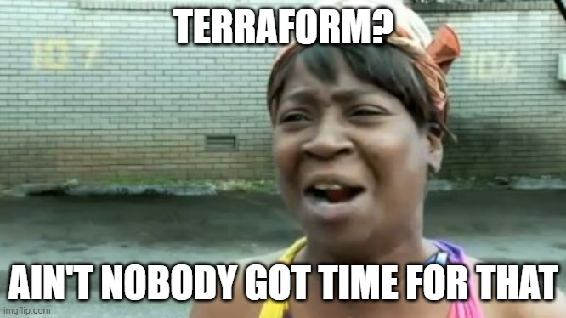
What’s on the agenda?
Terrawhat?
Like for real, what is terraform?
Terrawhy?
Like why would i even bother?
Terrahow?
Like how the flagnot does this work?

Slide 4

Terrawhat?
Infrastructure as code provider
Alternative: AzureRm
Uses the code to change the infrastructure to reflect the code (declarative)
Integrates in build & deploy pipelines
Industry standard
Free (paying gives you some management stuff)

Slide 5

Terrawhy?
Infrastructure is version controlled
Easier to manage
Redeploy to different environments (test, dev, qa, production, …) is peanuts when setup
Destroying an environment is supah easy without worrying about destroying too much or too little
Uses storage account to store a backend containing the state
We like code!

Slide 6
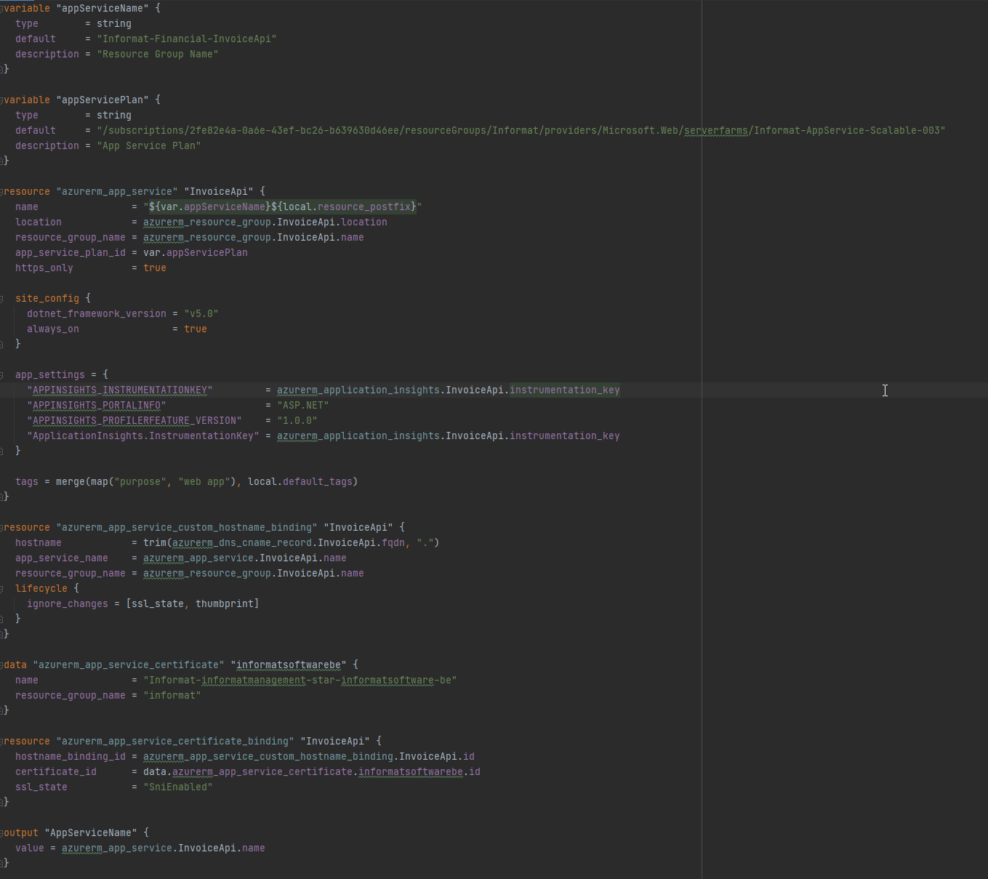
Terrahow
By showing some examples?

Slide 7


Slide 8
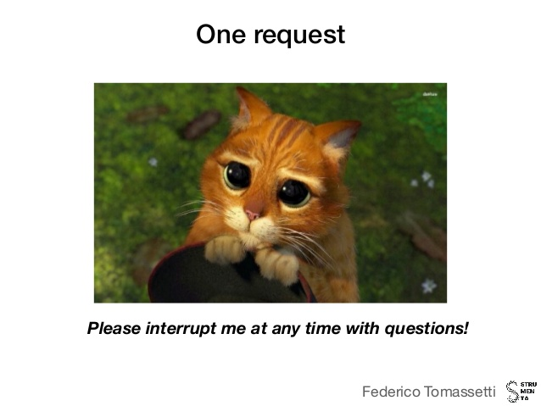
DEMO-O-CLOCK!
Doing stuff one step at a time!
get the powerpoint and demo files here
https://github.com/johnverbiest/Terraform101-KnowledgeShare

Slide 9
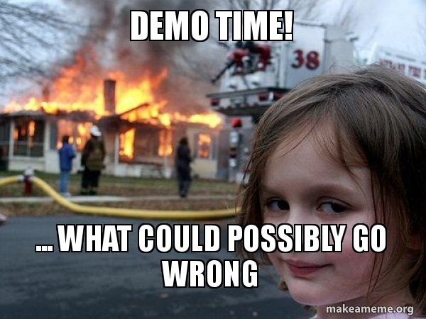
What will we terraform?
We will create a website with a dev and a production environment, hosted as
awesomewebsite-dev.masterofdisaster.be
awesomewebsite.masterofdistaster.be
There will be a storage account, application insights and a sql database
All the connectionstrings are automatically provided in the settings of the web application and DNS settings are correct
All connectionstrings and web app are exported as variables to be used in a deployment pipeline

Slide 10
1. Installing all the things
You need 2 things on your machine:
Terraform v 0.15.1
From their website, or via chocolatey for windows (choco install terraform --version=0.15.1)
Azure CLI
https://docs.microsoft.com/en-us/cli/azure/install-azure-cli
> choco install terraform --version=0.15.1 > Invoke-WebRequest -Uri https://aka.ms/installazurecliwindows -OutFile .\AzureCLI.msi; Start-Process msiexec.exe -Wait -ArgumentList '/I AzureCLI.msi /quiet'; rm .\AzureCLI.msi

Slide 11
2. Login into the CLI
Login using the CLI
az login
Opens browser to login into Azure
> az login

Slide 12
3. Create a backend
Backend is same for a complete system, including environments and multiple terraform setups. We can thus create a single “shared” backend.
I created a Resource manager file to automate this, but it is nothing more than creating a resource group, storage account and a key vault containing connection strings.
When it asks for a “keyVaultOwnerId”, lookup your own object id in the azure ad and supply this
> az group create -l westeurope -n demoTerraformBackend
> az deployment group create --name Deploy-30-04-2021 --resource-group demoTerraformBackend --template-file .\TerraformRemoteState.json
Notes:
Get the keyVault owner id from azure portal -> Active directory -> users -> yourself -> object id

Slide 13
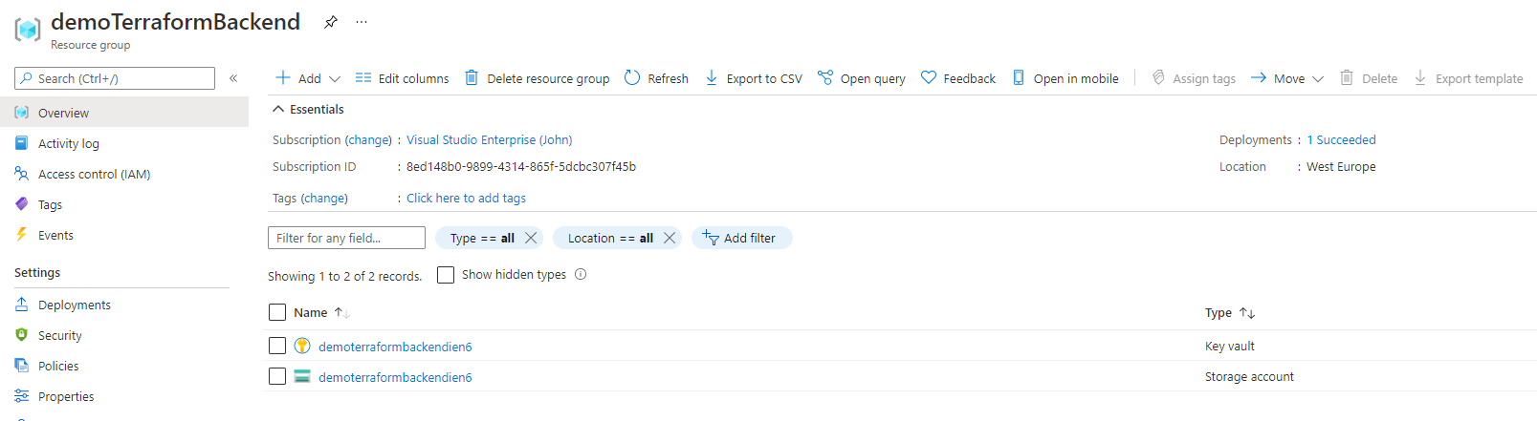
it worked!

Slide 14
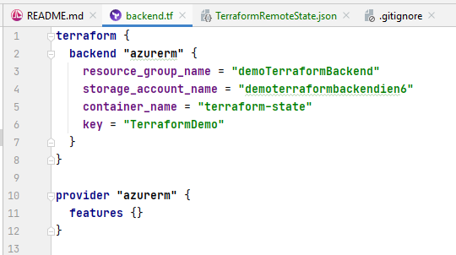
4. Backend setup
Create a first terraform file:
backend.tf
This file tells terraform that we will be storing our backend in the Azure Storage account we’ve created. The key is a “group name” for all the deployments from this terraform folder/repository
PS: In official documentation you will see this in the main.tf, but I like to structure the files and their names by the tasks they perform.

Slide 15
5. Energize!
Terraform init will initialize the backend, and put some temporary files on your computer to remember the connection and some state stuff.
We are now ready to terraform!
yay!
> terraform init

Slide 16
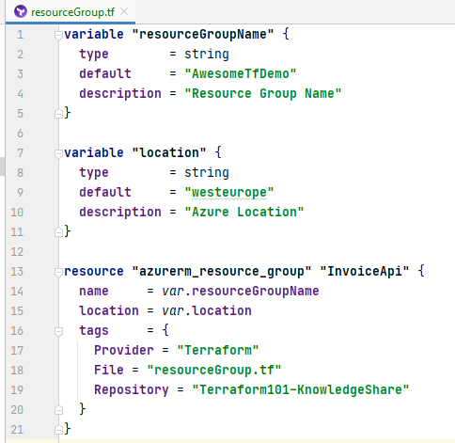
6. The Resource Group
First we will create a resource group to put all our stuff in.
It’s imporant to know that in this case the resource group itself is managed by terraform and you should not put any resources in that resource group by hand. Once a resource group goes terraform, terraform is the boss.

Slide 17
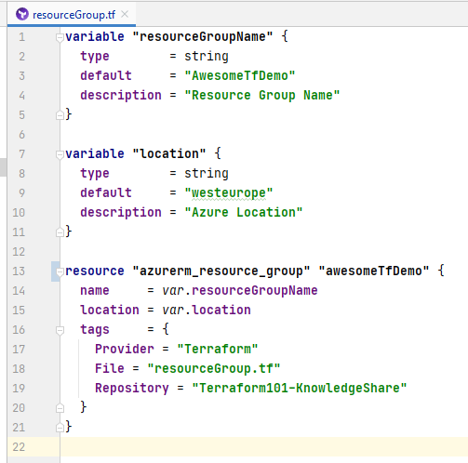
6. The Resource Group
resourceGroupName and location are variables
This ensures maximum flexibility when deploying to other environments
The “resource” makes use the variables
The resource header is defined as:
resource <<type>> <<name>>
the name is used to reference this resource in other resources
We added tags so in the portal it is clear where these resources came from

Slide 18
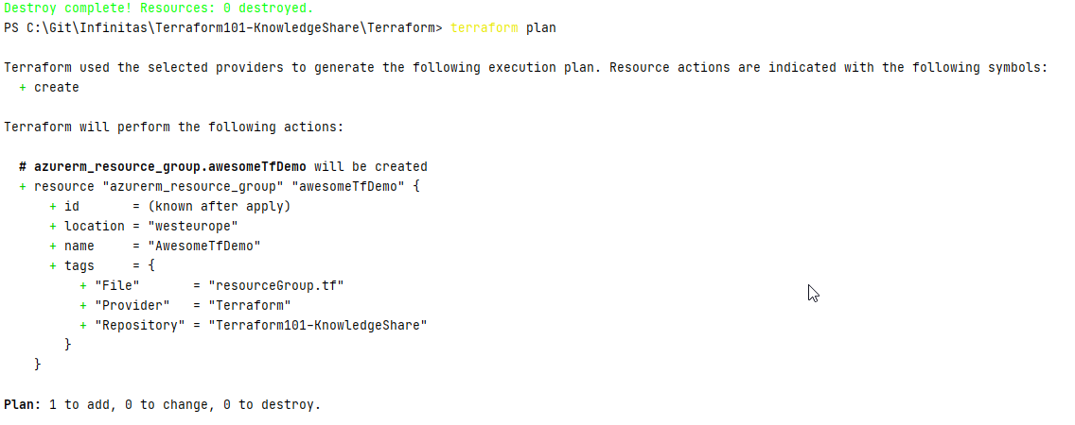
6. The Resource Group – plan and apply
We can now see what terraform would do to the Azure environment if we would apply it
type “terraform plan”

Slide 19
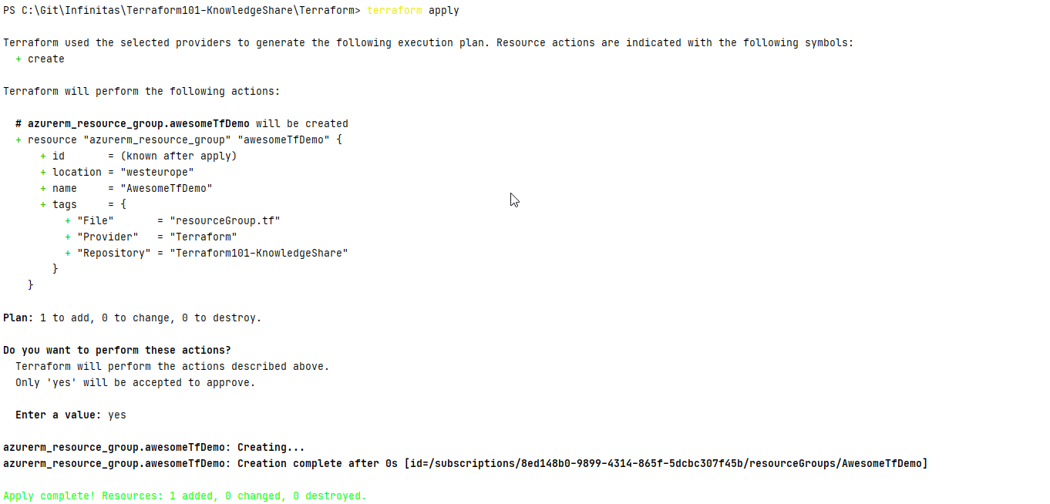
6. The Resource Group – plan and apply
Let’s apply this
terraform apply

Slide 20
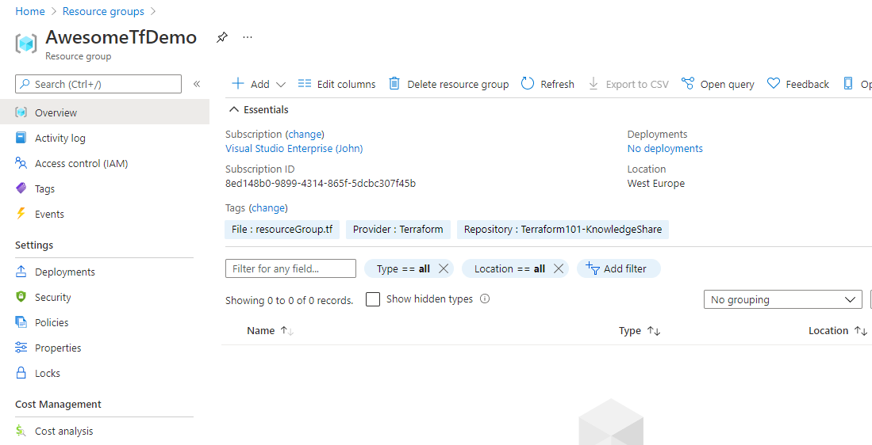
6. The Resource Group – plan and apply

Slide 21
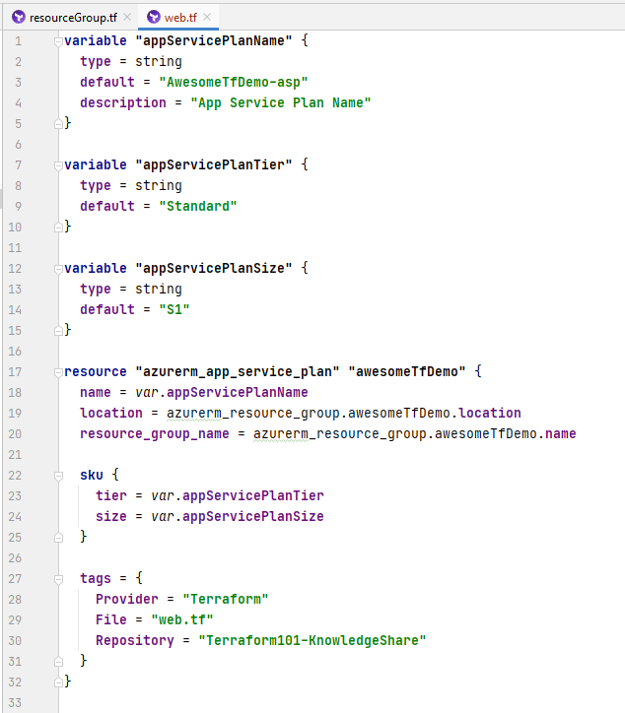
7. The Web App – App Service Plan
Again we see 3 variables, to dymanically change during deployment time
The “location” and “resource_group_name” values of the appservice plan is however not coming from a variable, but is coming from the resource group
This will reflect itself in the dependency tree, making it so that terraform creates the resource group befor the app service plan

Slide 22
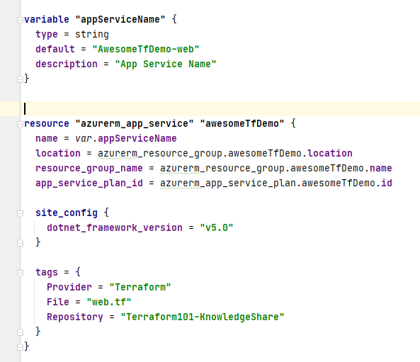
7. The Web App – App Plan
Continuing the web.tf file, we find ourselves in the secion of the app service.
App service references the app_service_plan so this will be created after the app service plan.
The order of the files and the order in the files do not matter, dependencies are build from these references

Slide 23
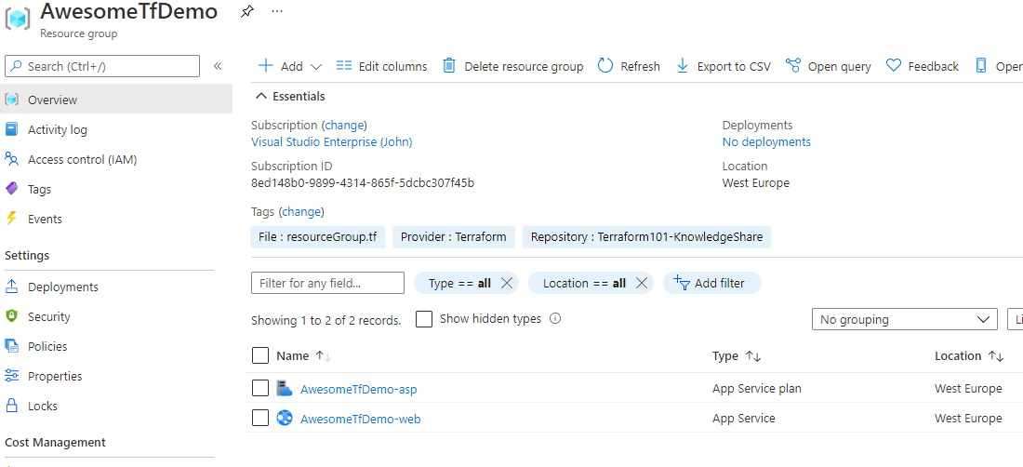
7. The Web App – Deploy

Slide 24
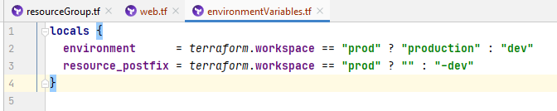




Weren’t we building dev? – Making a postfix
Creating local variables depending on the workspace
if workspace = unknown => dev
else => production
Using this in the naming will create a dev environment for us
As you can’t change the name of a resource, 3 new ones will be created.

Slide 25
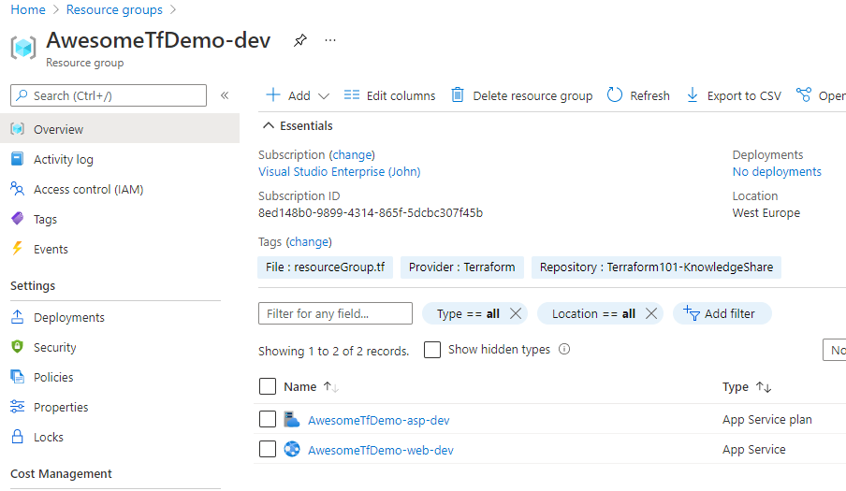
Weren’t we building dev? – Making a postfix

Slide 26
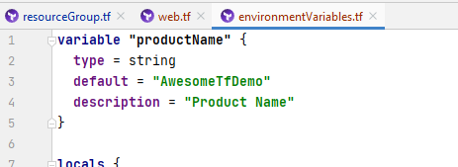
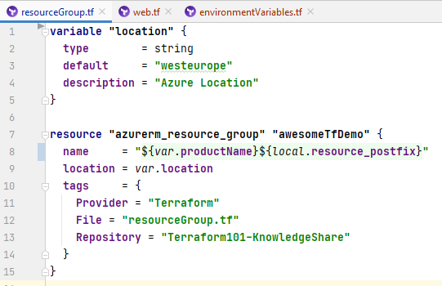
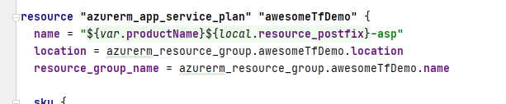
Lets make the naming DRY
We want a controlled naming convention
<productname>(-<environment>)-<service>
At the moment we keep repeating ourselves, this will we fix with a variable, containing the productname
We remove all specific naming variables and replace it with our convention

Slide 27
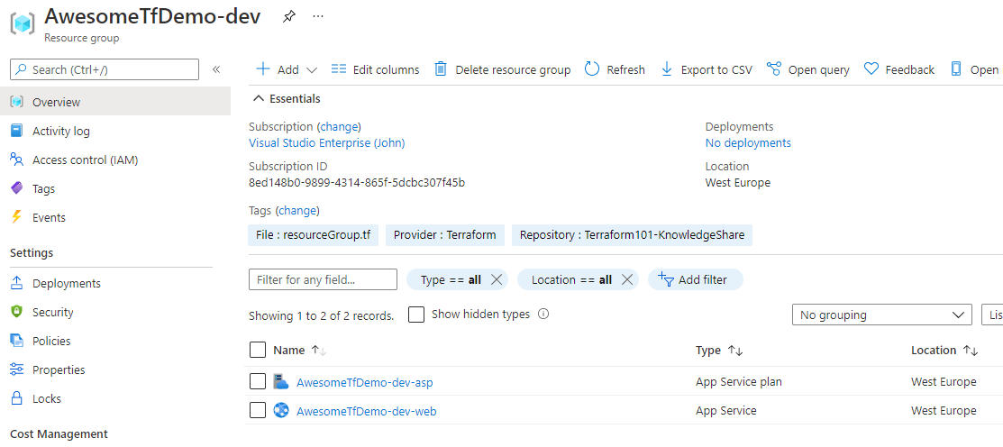
Lets make the naming DRY

Slide 28
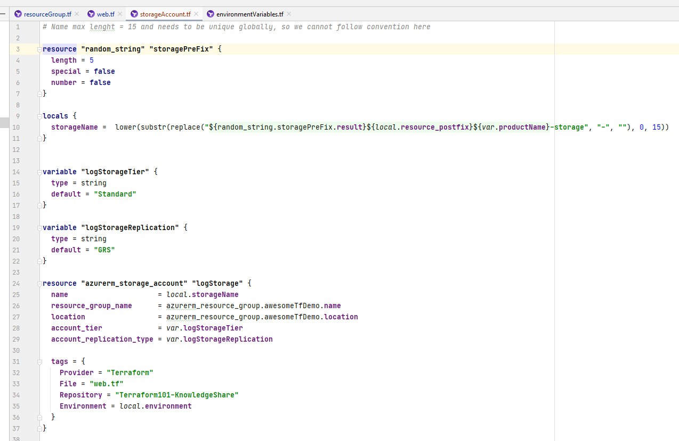
8. Storage Account
Naming is difficult here
Globally unique
15 chars
lowercase
no special chars
Done with a random_string (saved in state) and a function, creating a local storageName with the final name in it.

Slide 29
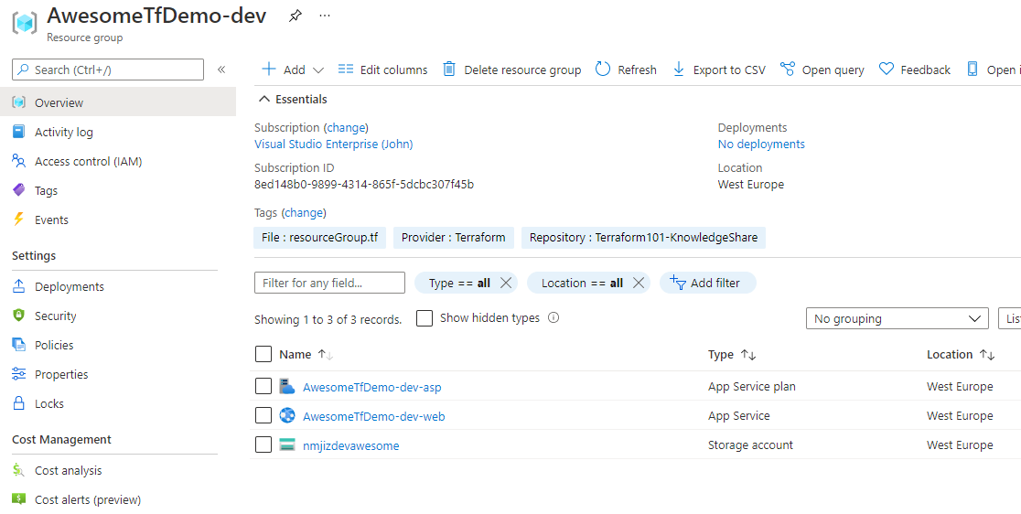
8. Storage Account

Slide 30
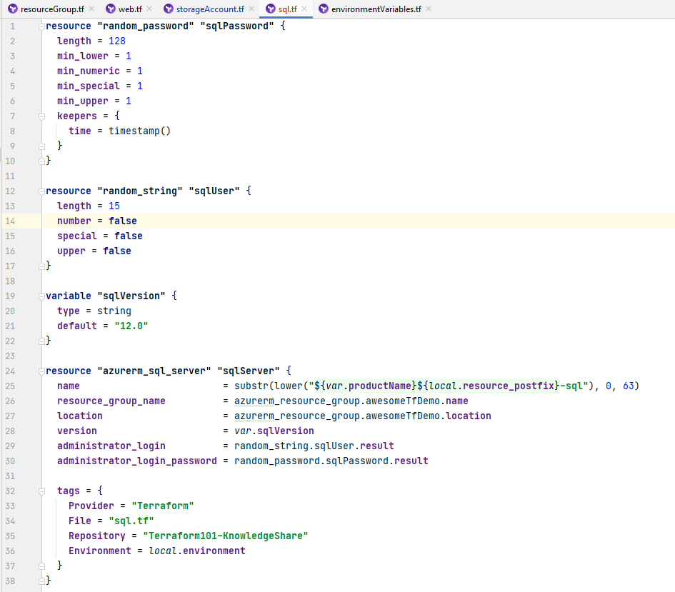
9. SQL Server
Added a strong random password and a random sql user for the sql server
Keepers = timestamp makes sure the password is changed on every deploy, thus increasing security
If you don’t specify a keeper, the random string, number or password is kept as long as you don’t change a property of the random object.

Slide 31
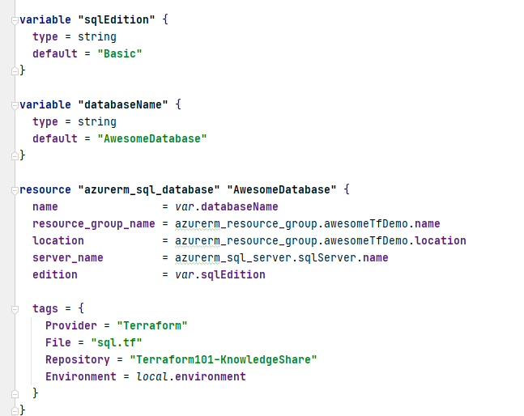
9. SQL Database
Nothing special to see here

Slide 32
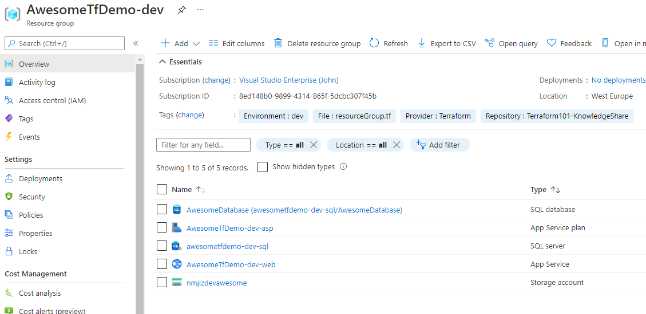
9. SQL Database

Slide 33
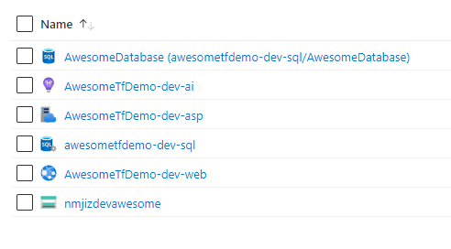
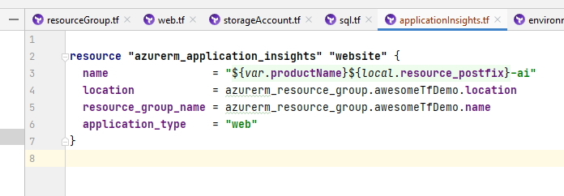
10. Application Insights

Slide 34
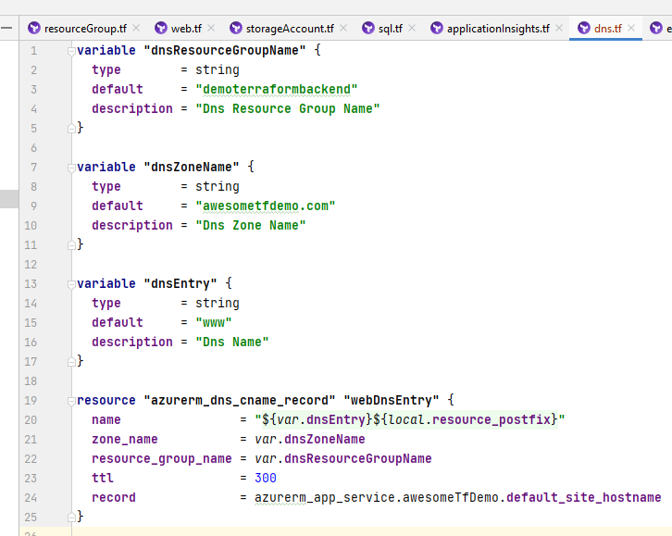
11. DNS – part one
DNS zone is out of scope (shared amongs different deployments => seperate deployment)
For a web app, you need a CNAME entry

Slide 35
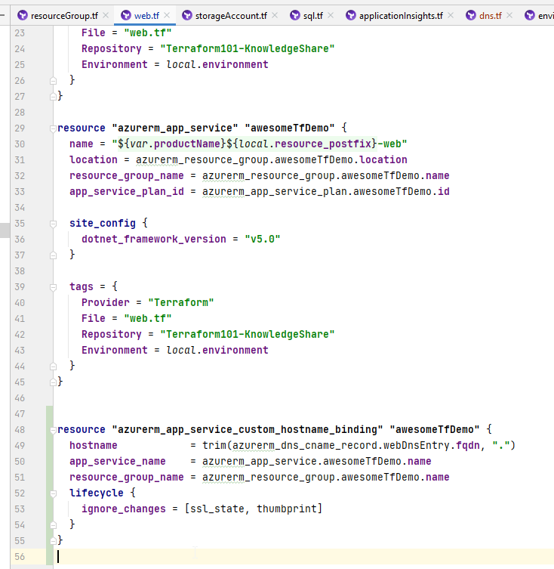
11. DNS – part two
Adding the custom domain to the web app in web.tf
Ignoring ssl_state and thumbprint for this binding because these are setup seperatly (and not in scope of this “short” demo)

Slide 36
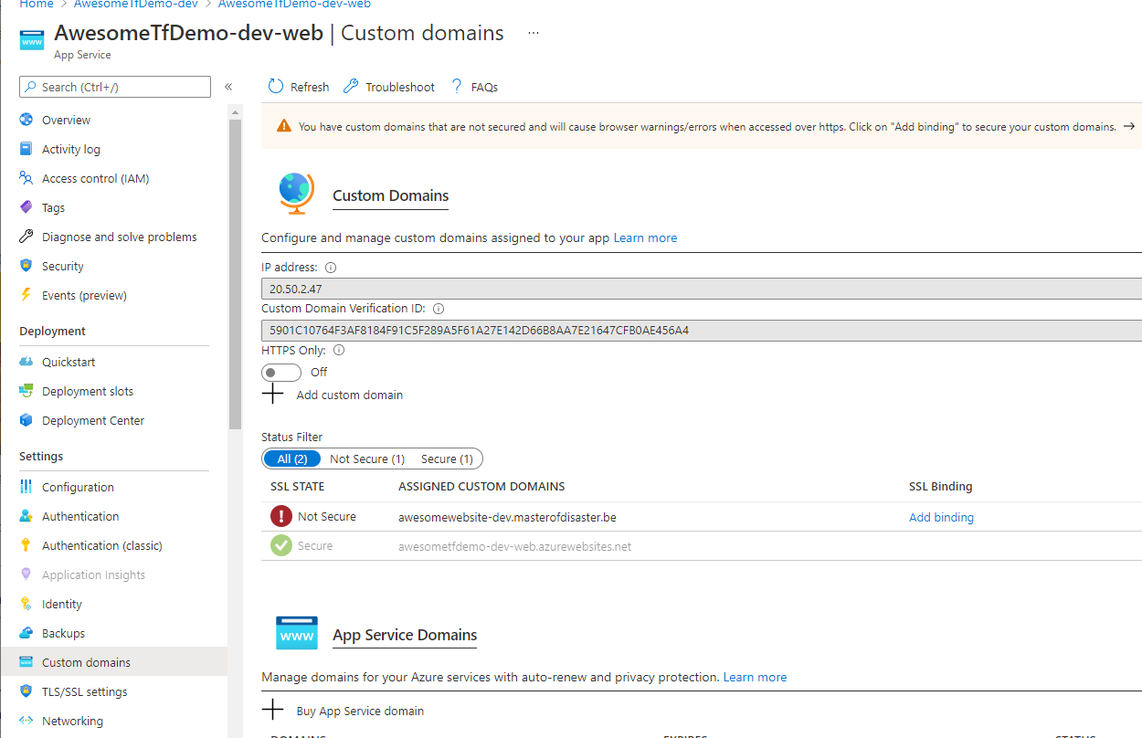
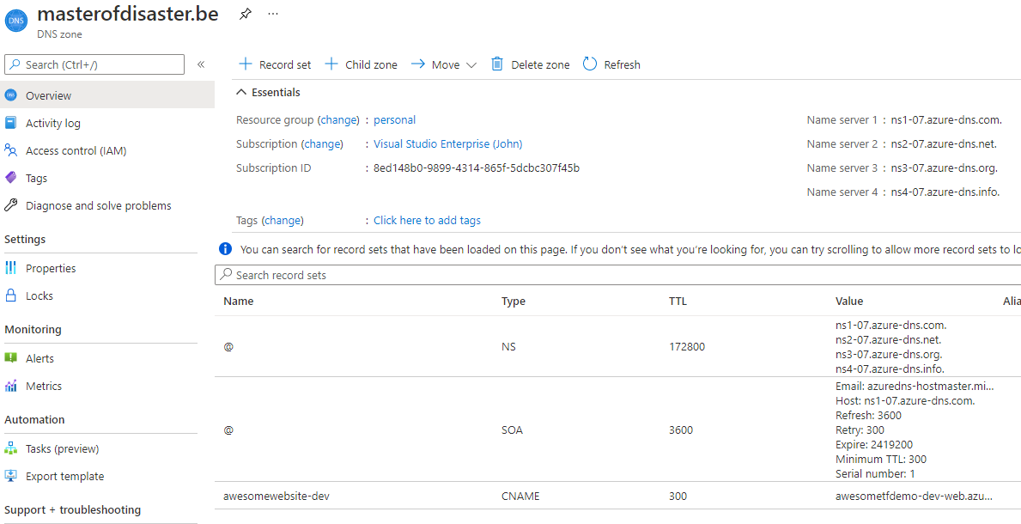
11. DNS – part two

Slide 37
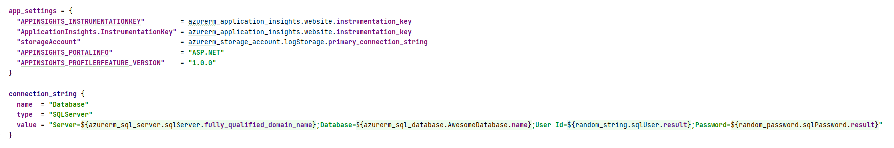
12. App Settings
You can use values from the other “services” to populate the app_settings or the connection_string
I know, using the admin account as the connection_string is not done, but it’s just an example

Slide 38
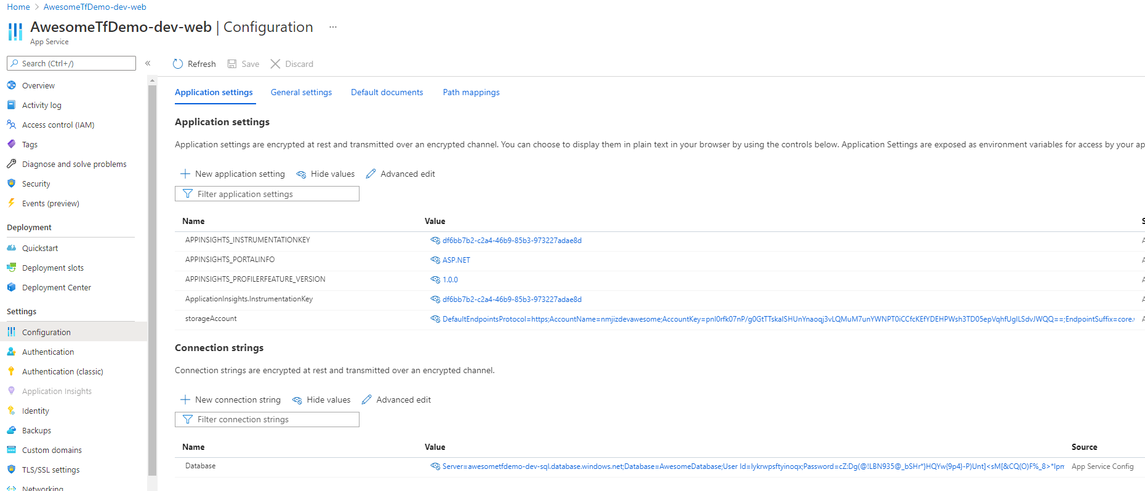
12. App Settings

